Slide 2
01 | EXECUTIVE VIEW
Revenue is steady, with clear areas to grow.
The biggest opportunities are the products we sell and the months when demand is strongest.
REVENUE ENGINE
GROWTH WINDOW
OPERATING MODEL
Coffee and tea bring in the most revenue. Keep them available and easy to find.
June is the strongest month. January and February are the weakest.
Revenue is spread fairly evenly across stores and days.
CEO takeaway
The focus should be simple: protect what already sells well, then use targeted offers to grow weaker areas.
BRIGHT COFFEE | REVENUE PERFORMANCE
02

Slide 3
AGENDA
01 Executive View
05 Revenue by Location & Time of Day
02 Sales Trend – Monthly
06 Revenue by Product Category
03 Sales Trend – Daily
07 Revenue by Product Type
04 Revenue by Store Location
08 CEO Action Plan

Slide 4
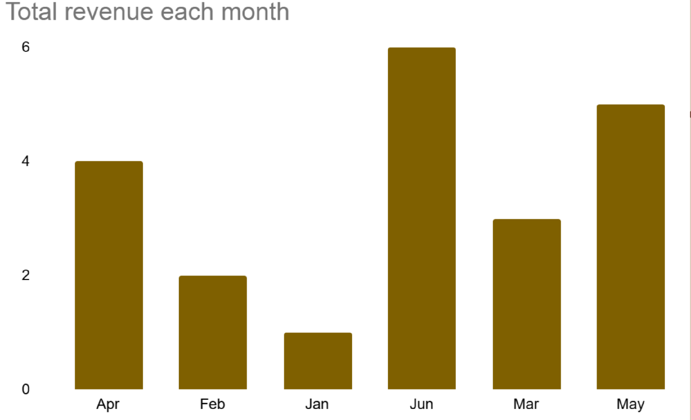
02 | SALES TREND
June is the strongest month for revenue.
Revenue is much stronger in some months than others.
INSIGHT
Revenue is lowest in January and February, then rises through May to its highest point in June.
RECOMMENDATION
Plan stock and staffing ahead of May and June. Use simple promotions in January and February to bring customers back.
BRIGHT COFFEE | REVENUE PERFORMANCE
03

Slide 5
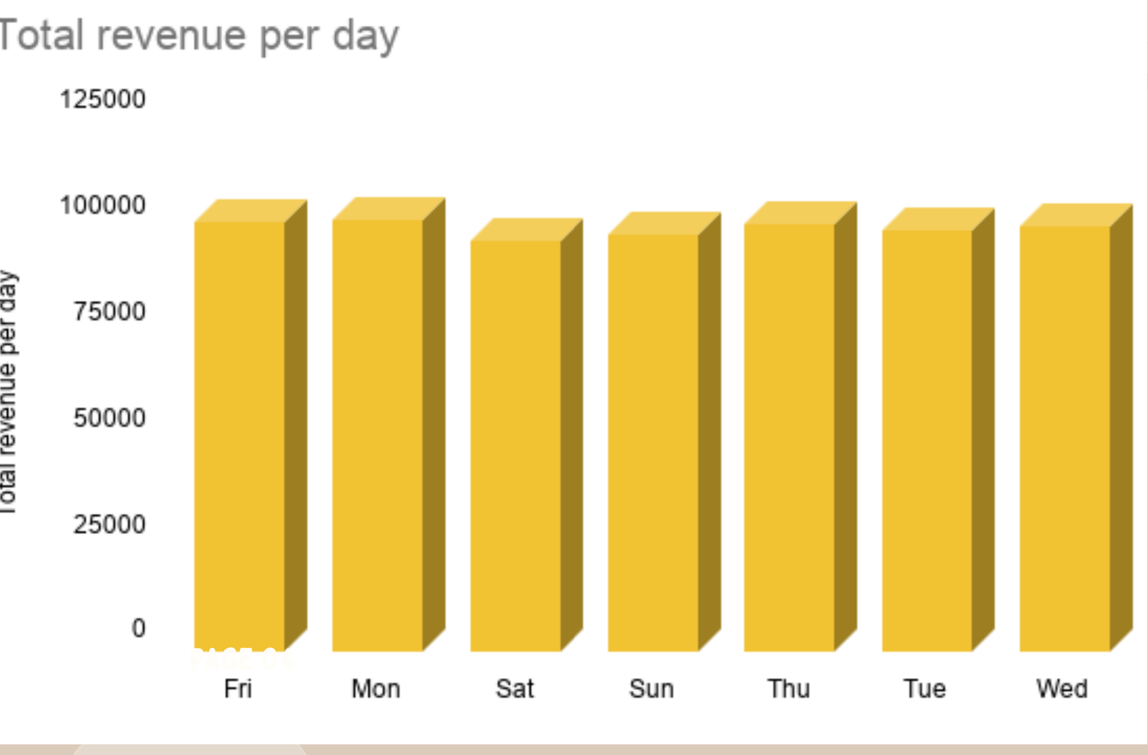
03 | DAY-OF-WEEK PERFORMANCE
Daily revenue is fairly steady.
No single day carries the business.
INSIGHT
Revenue stays within a narrow range across the week. Monday, Thursday, and Friday are slightly stronger, while Saturday is lower.
RECOMMENDATION
Keep staffing fairly consistent. Use small promotions on softer days instead of making big changes to the weekly schedule.
BRIGHT COFFEE | REVENUE PERFORMANCE
04

Slide 6
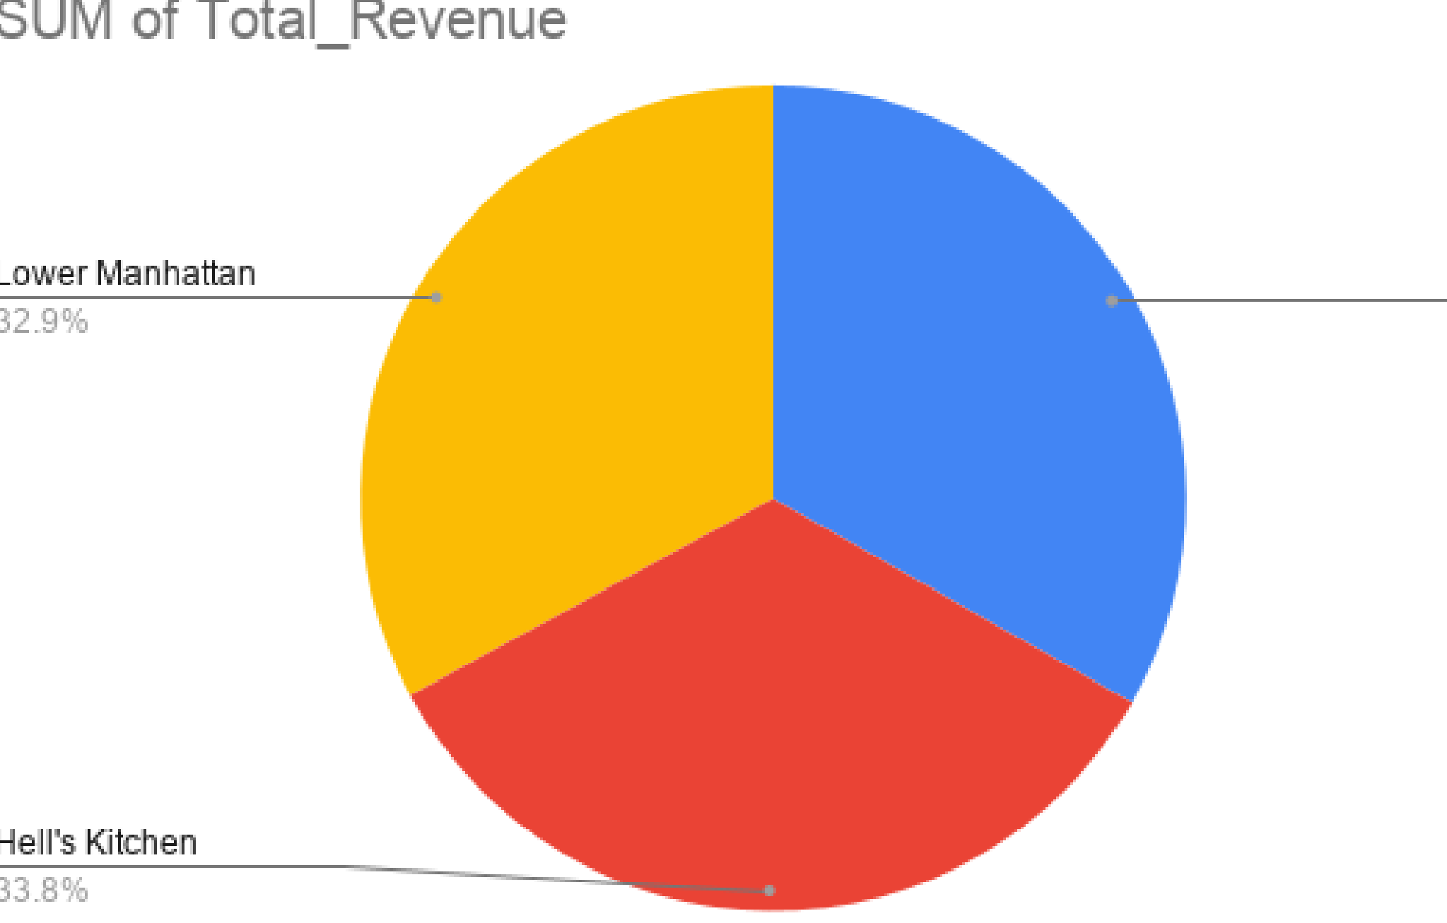
04 | LOCATION DISTRIBUTION
Revenue is fairly balanced across the three stores.
No single store dominates total revenue.
INSIGHT
Hell’s Kitchen contributes about 33.8% and Lower Manhattan about 32.9%, with the remaining share coming from the third store.
RECOMMENDATION
Do not move investment based on revenue alone. Compare customer numbers and average spend to see where each store can grow.
BRIGHT COFFEE | REVENUE PERFORMANCE
05

Slide 7
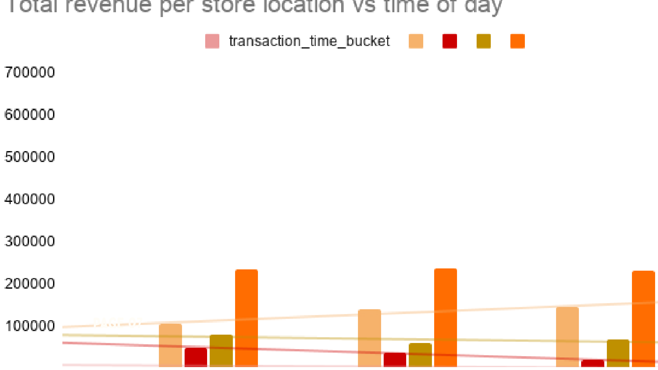
05 | LOCATION × TIME OF DAY
Astoria may have an evening opportunity.
The stores are similar through the day, with one useful difference.
INSIGHT
Revenue is similar across stores during the day, but Astoria appears stronger at night.
RECOMMENDATION
Test an evening offer in Astoria. Adjust staffing and stock, then measure the extra revenue before rolling it out.
BRIGHT COFFEE | REVENUE PERFORMANCE
06

Slide 8
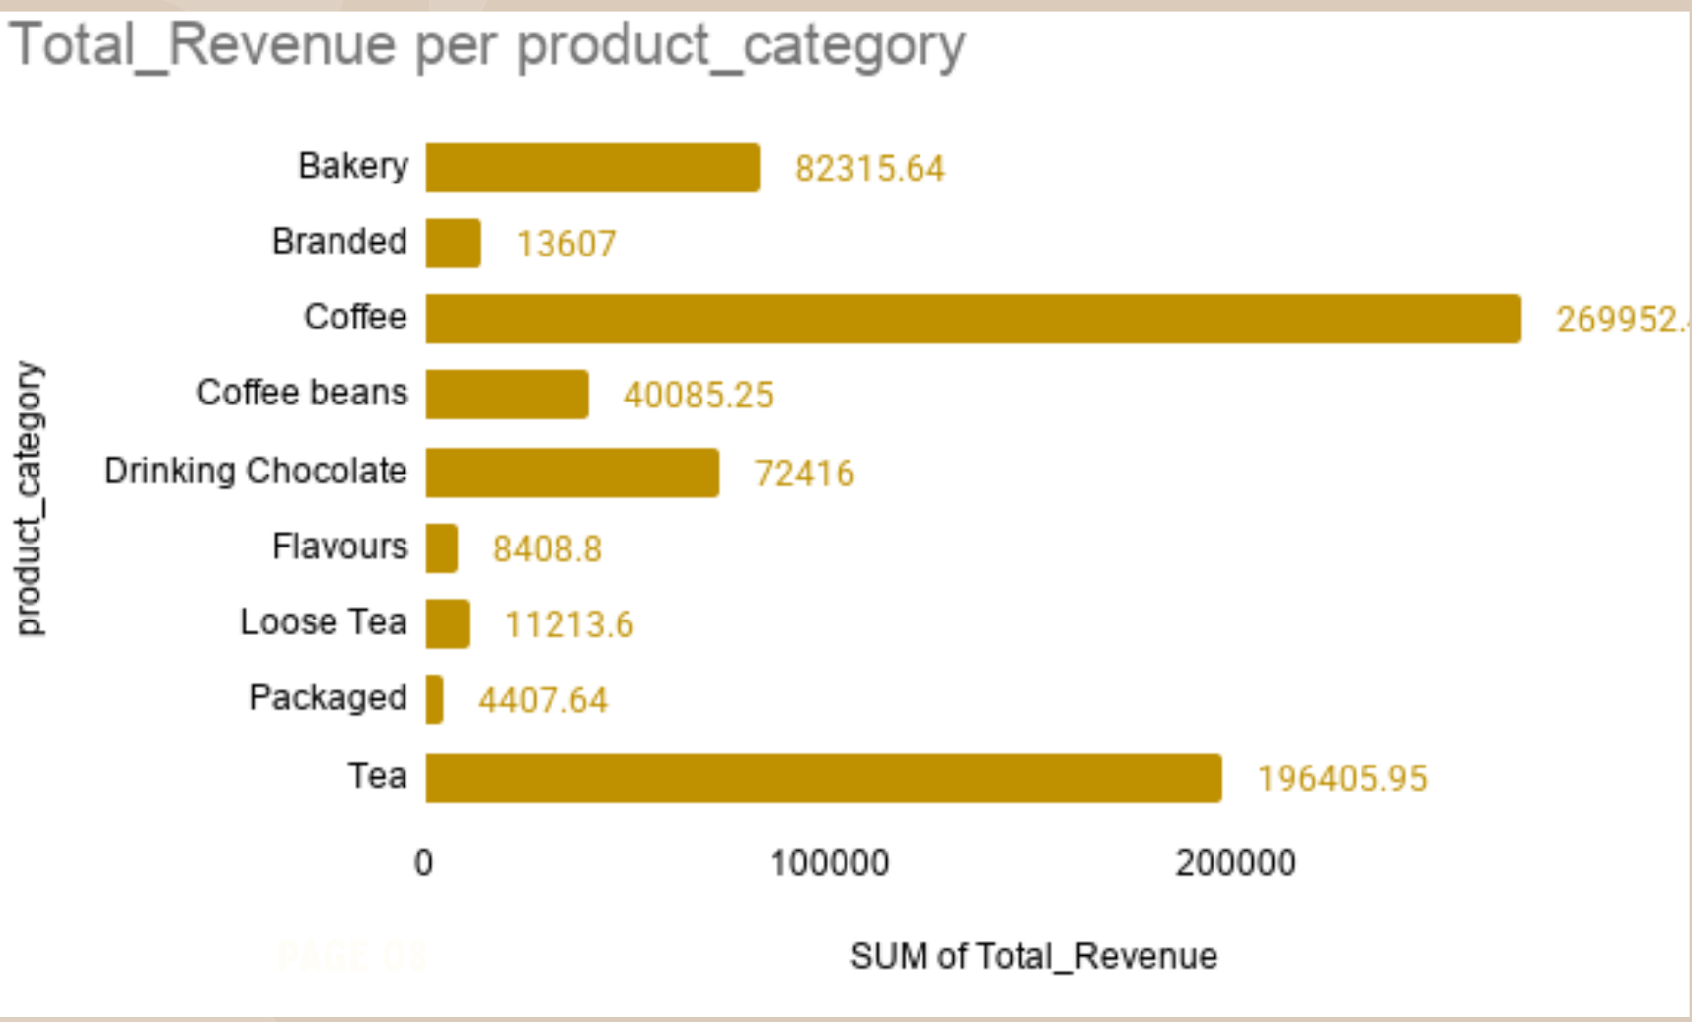
06 | PRODUCT CATEGORY PERFORMANCE
Coffee and tea are the main revenue drivers.
The category mix shows where Bright Coffee should focus.
INSIGHT
Coffee brings in roughly 270K, followed by tea at roughly 196K. Bakery and drinking chocolate are also useful contributors.
RECOMMENDATION
Keep coffee and tea well stocked and visible. Use bundles to add bakery and other lower-revenue items to popular purchases.
BRIGHT COFFEE | REVENUE PERFORMANCE
07

Slide 9
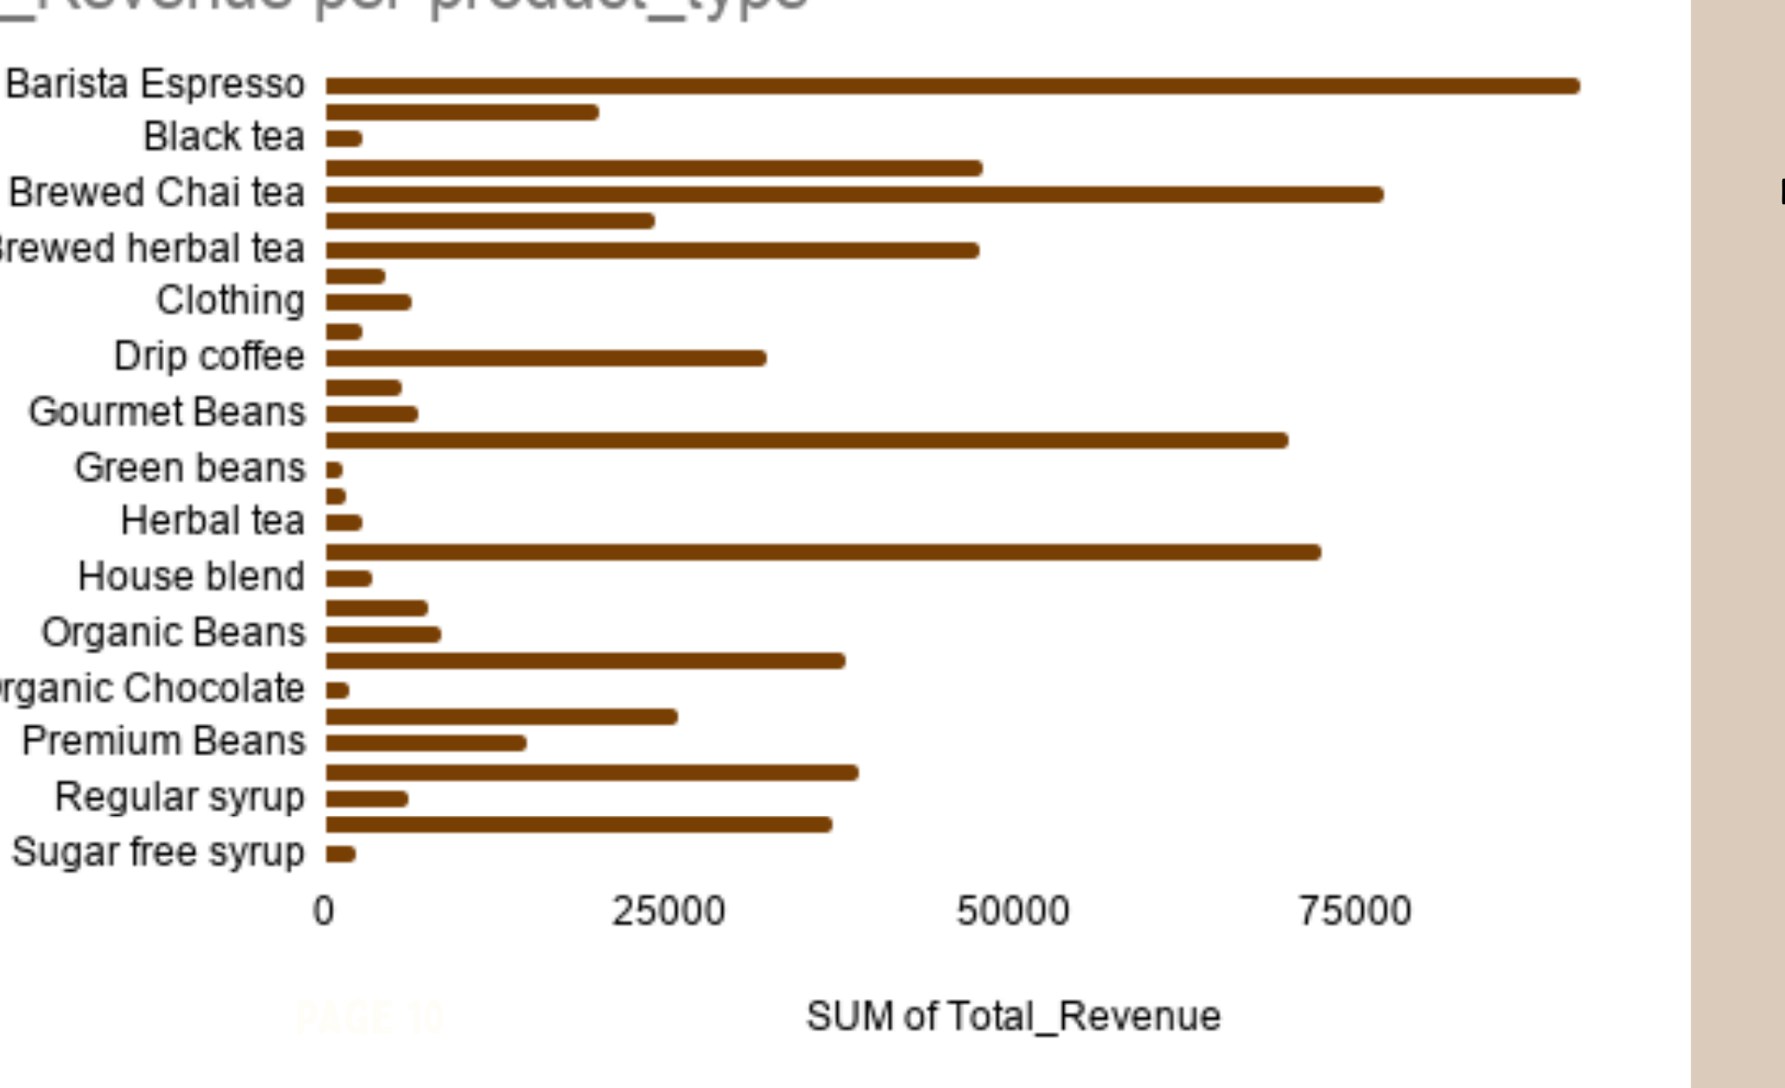
07 | PRODUCT TYPE PERFORMANCE
A few products bring in much more revenue than the rest.
Protect the best sellers and give weaker products a chance to improve.
INSIGHT
Barista Espresso is the clear standout, with Brewed Chai Tea, Gourmet Beans and House Blend also performing well.
RECOMMENDATION
Keep top sellers in stock, promote mid-level products, and test weaker products before deciding whether to remove them.
BRIGHT COFFEE | REVENUE PERFORMANCE
08

Slide 10
08 | CEO ACTION PLAN
Five practical actions to grow revenue.
Protect the core, then grow the weaker areas.
Protect the core
Keep coffee, tea, and the best-selling products in stock and easy to find.
01
Attack the weak months
Run simple January–February promotions to bring demand back up.
02
Lift basket size
Test coffee or tea with bakery bundles and track average spend per customer.
03
Localise the playbook
Use each store’s strongest trading times to plan staff, stock, and promotions.
04
Test, measure, scale
Test Astoria evening offers first, measure the result, and then scale what works.
05
BRIGHT COFFEE | REVENUE PERFORMANCE
09

Slide 11


